Slide 1
Linear Programming
Jiayin Xie
04/07/2018

Slide 2
Outline
Introduction and Motivation
Standard form
Algorithm

Slide 3
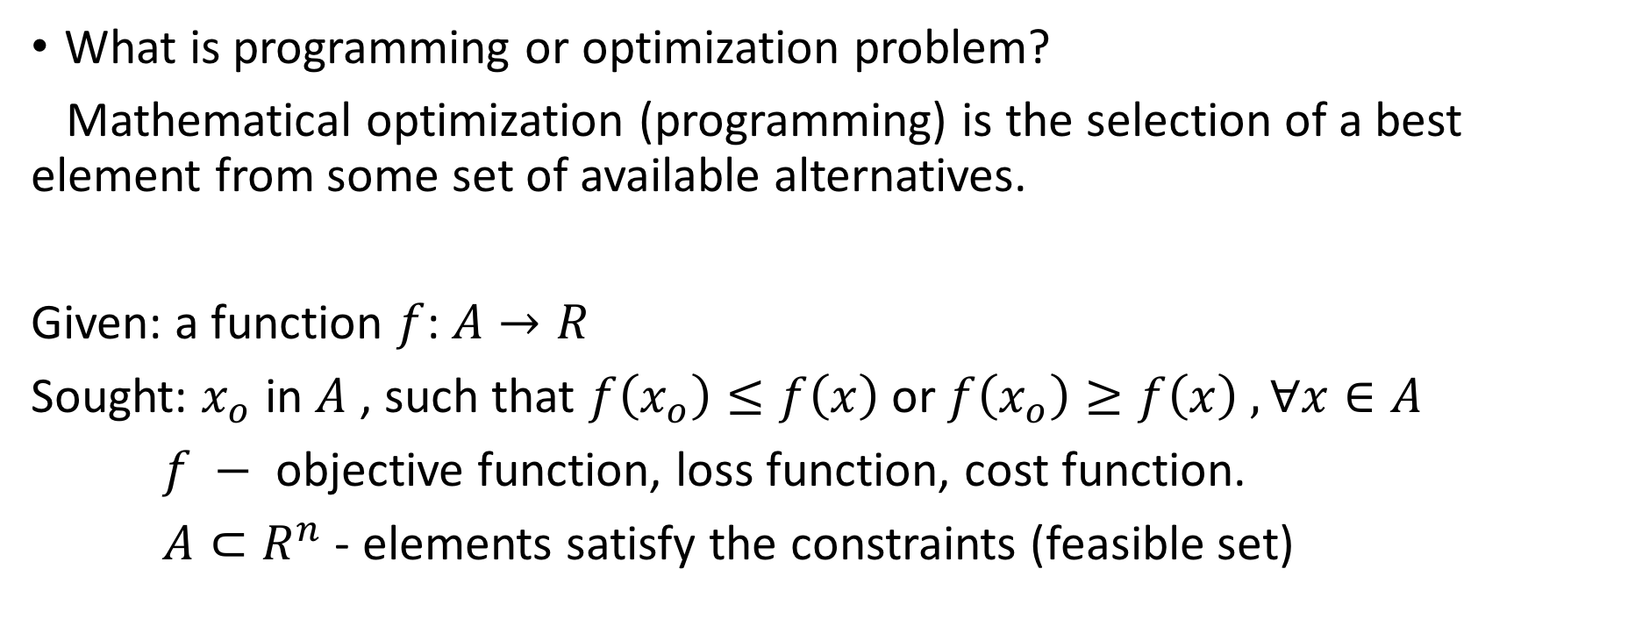
Introduction and Motivation
What is programming or optimization problem?
Mathematical optimization (programming) is the selection of a best element from some set of available alternatives.
Given: a function $f$: $A→R$
Sought: $x_{o}$ in $A$ , such that $f\left(x_{o}\right)≤f\left(x\right)$or $f\left(x_{o}\right)≥f\left(x\right) , ∀x∈A$
$f −$ objective function, loss function, cost function.
$A⊂R^{n}$ - elements satisfy the constraints (feasible set)

Slide 4
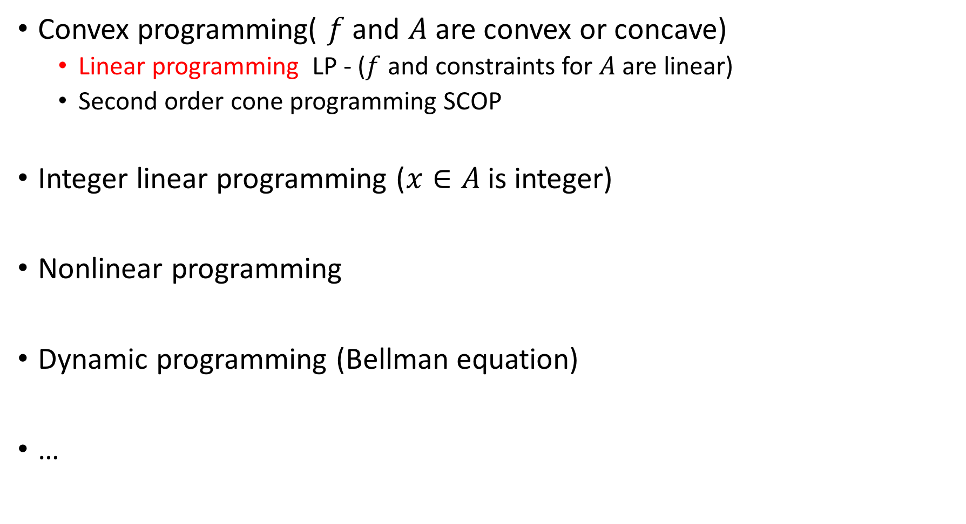
Major subfields:
Convex programming( $f$ and $A$ are convex or concave)
Linear programming LP - ($f$ and constraints for $A$ are linear)
Second order cone programming SCOP
Integer linear programming ($x∈A$ is integer)
Nonlinear programming
Dynamic programming (Bellman equation)
…

Slide 5
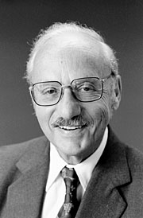
Motivation from history
During 1946–1947, George B. Dantzig independently developed general linear programming formulation to use for planning problems in US Air Force. In 1947, Dantzig also invented the simplex method that for the first time efficiently tackled the linear programming problem in most cases. When Dantzig arranged a meeting with John von Neumann to discuss his simplex method, Neumann immediately conjectured the theory of duality by realizing that the problem he had been working in game theory was equivalent. Dantzig provided formal proof in an unpublished report "A Theorem on Linear Inequalities" on January 5, 1948.^{[4]} In the post-war years, many industries applied it in their daily planning.
- from WikiPedia
George Dantzig

Slide 6
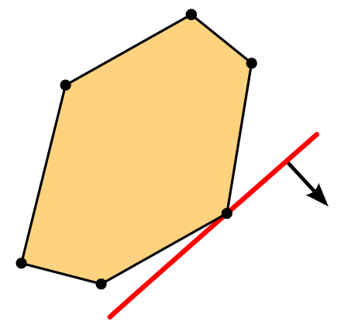
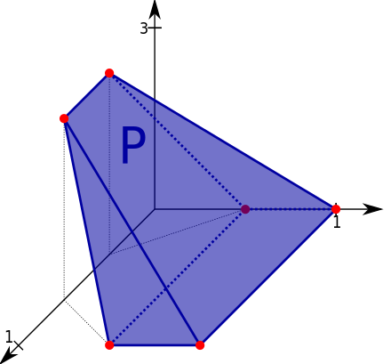
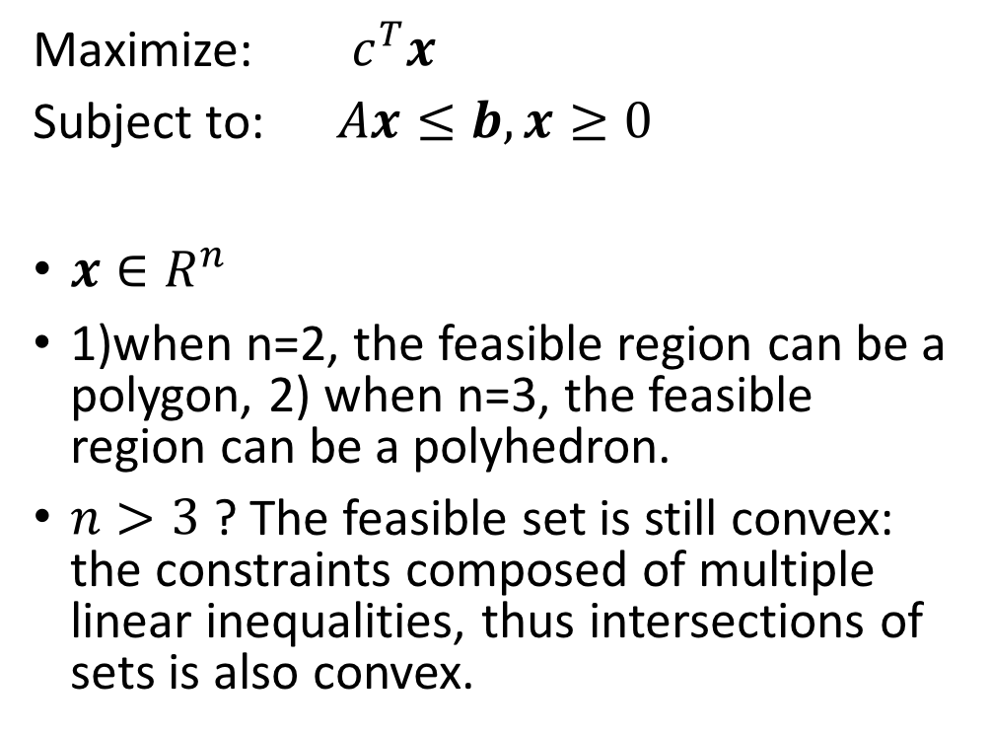
Standard form of linear Programming
Maximize: $c^{T}x$
Subject to: $Ax≤b,x≥0$
$x∈R^{n}$
1)when n=2, the feasible region can be a polygon, 2) when n=3, the feasible region can be a polyhedron.
$n>3$ ? The feasible set is still convex: the constraints composed of multiple linear inequalities, thus intersections of sets is also convex.

Slide 7
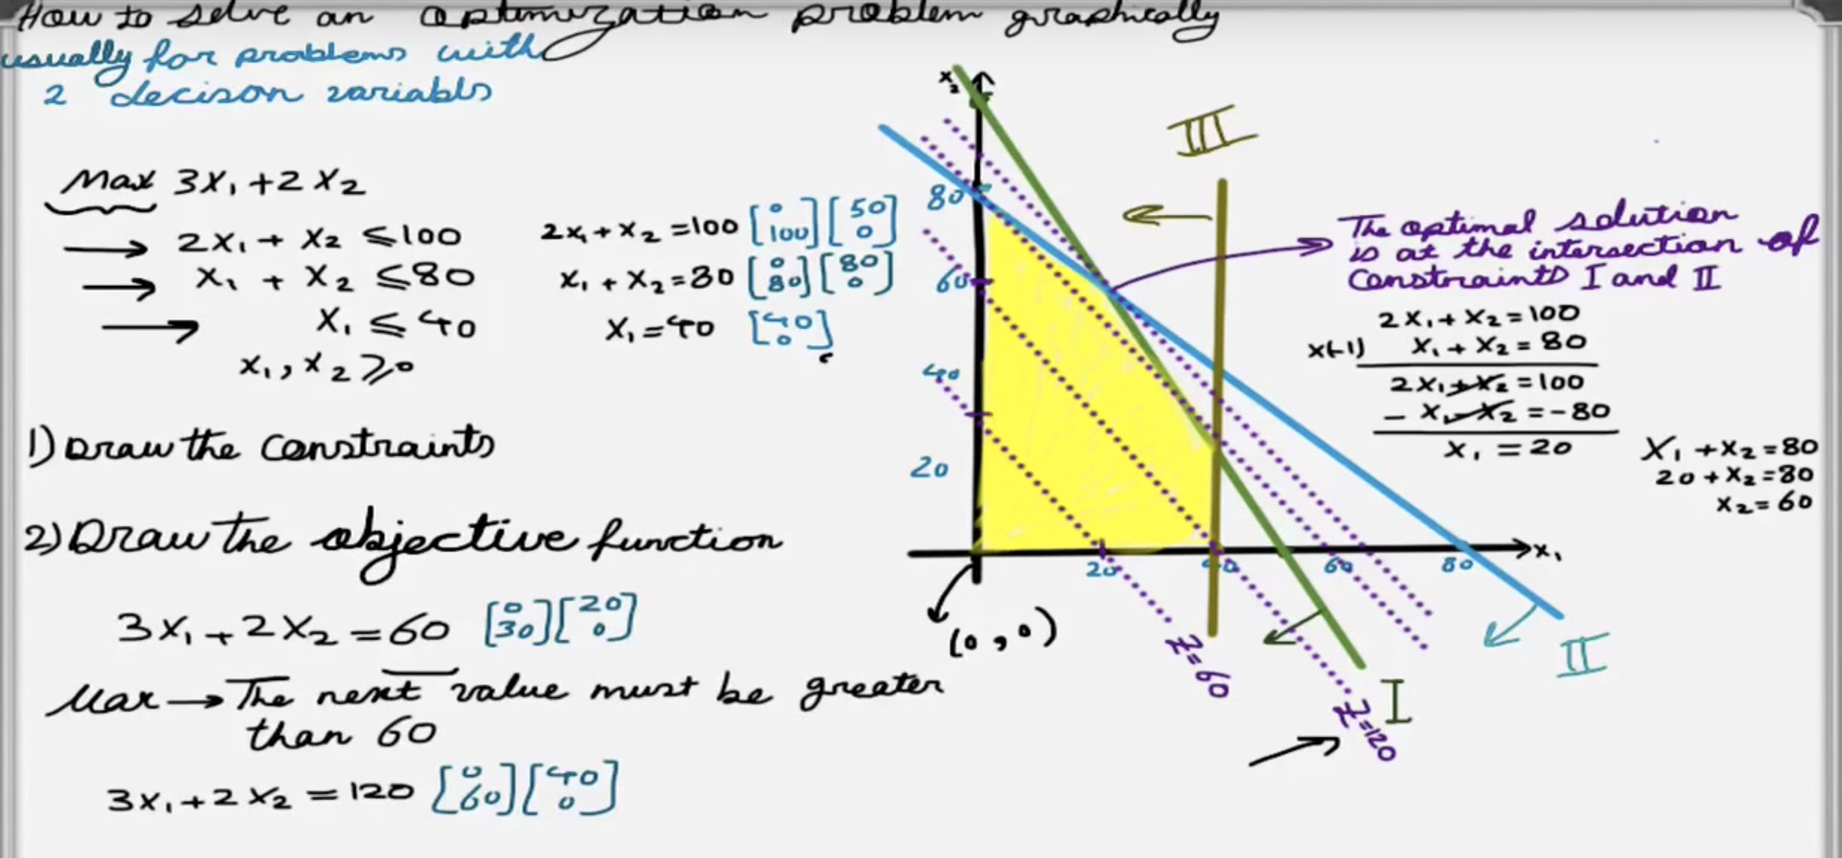
How to solve the problem?
In low dimension (n =2), we can solve the problem with Graphical Method!

Slide 8
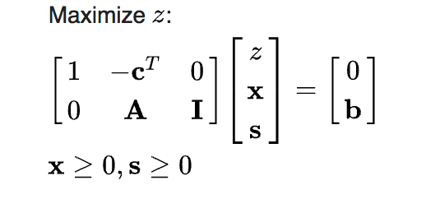
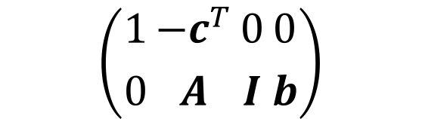

But what if the dimension is higher (n > 2)? – simplex Method!
1) slack form: introduces non-negative slack variables to replace inequalities with equalities in the constraints.
Ex: $x_{1}+2x_{2}≤3$ , $x_{1}+2x_{2}+s_{1}=3$.
2) Basic variables and non-basic variables
3) relative cost coefficients $c^{T}$
$$\left({1 \atop 0}{−c^{T} \atop A}{0 \atop I}{0 \atop b}\right)$$
Canonical tableau (contains Identity matrix)

Slide 9
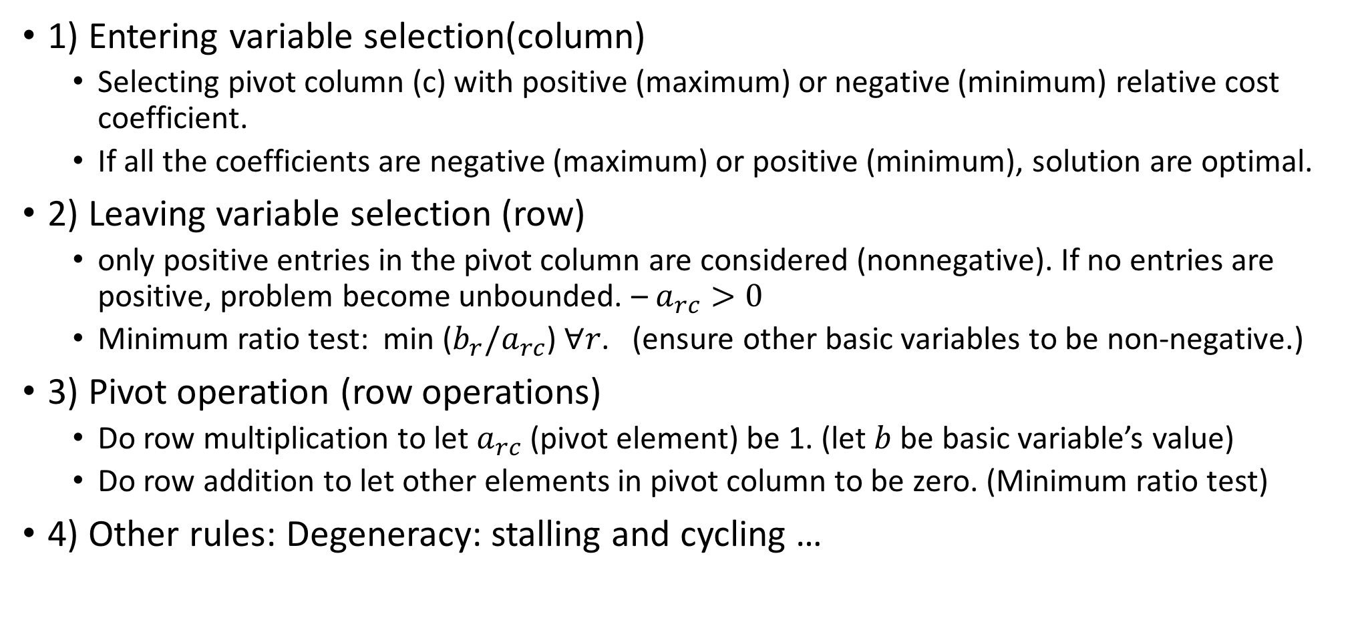
Basic rule for Simplex method
1) Entering variable selection(column)
Selecting pivot column (c) with positive (maximum) or negative (minimum) relative cost coefficient.
If all the coefficients are negative (maximum) or positive (minimum), solution are optimal.
2) Leaving variable selection (row)
only positive entries in the pivot column are considered (nonnegative). If no entries are positive, problem become unbounded. – $a_{rc}>0$
Minimum ratio test: min ($b_{r}/a_{rc}$) $∀r$. (ensure other basic variables to be non-negative.)
3) Pivot operation (row operations)
Do row multiplication to let $a_{rc}$ (pivot element) be 1. (let $b$ be basic variable’s value)
Do row addition to let other elements in pivot column to be zero. (Minimum ratio test)
4) Other rules: Degeneracy: stalling and cycling …

Slide 10
Summary for simplex method
Try to get the solution of linear systems, and number of unknowns is always bigger than the number of equations (#column > #row). Thus there exists basic variables and non-basic variables.
Elements in the tableau represents the associate coefficient in the equations. Pivot operation represents substitution to eliminate the variable in other equations and object function.

Slide 11
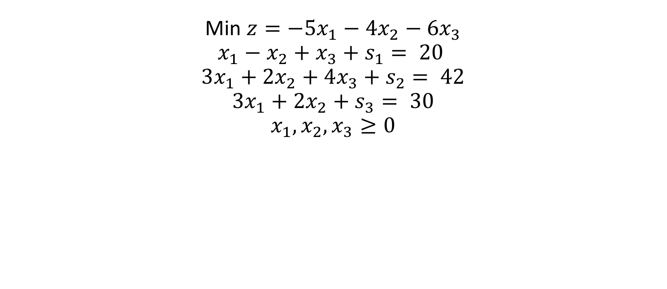
Examples
Min $z=−5x_{1}−4x_{2}−6x_{3}$ $$x_{1}−x_{2}+x_{3}+s_{1}= 20$$
$$3x_{1}+2x_{2}+4x_{3}+s_{2}= 42$$
$$3x_{1}+2x_{2}+s_{3}= 30$$
$$x_{1},x_{2},x_{3}≥0$$

Slide 12
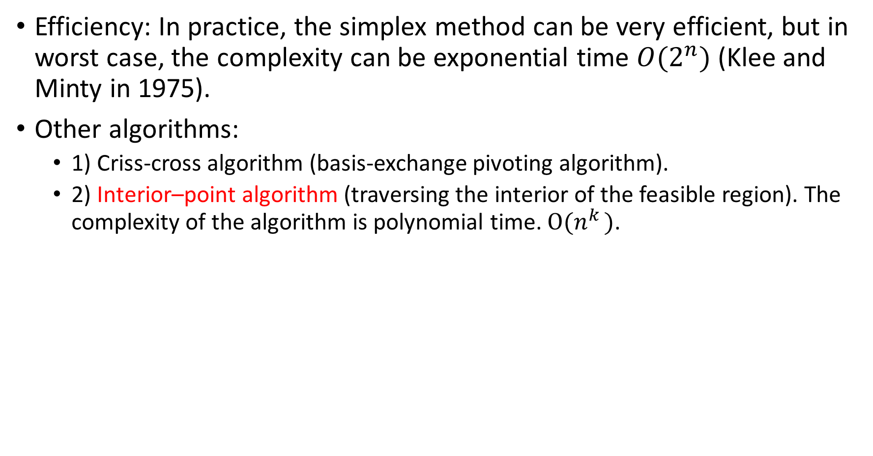
Algorithm:
Efficiency: In practice, the simplex method can be very efficient, but in worst case, the complexity can be exponential time $O(2^{n})$ (Klee and Minty in 1975).
Other algorithms:
1) Criss-cross algorithm (basis-exchange pivoting algorithm).
2) Interior–point algorithm (traversing the interior of the feasible region). The complexity of the algorithm is polynomial time. $O(n^{k })$.

Slide 13
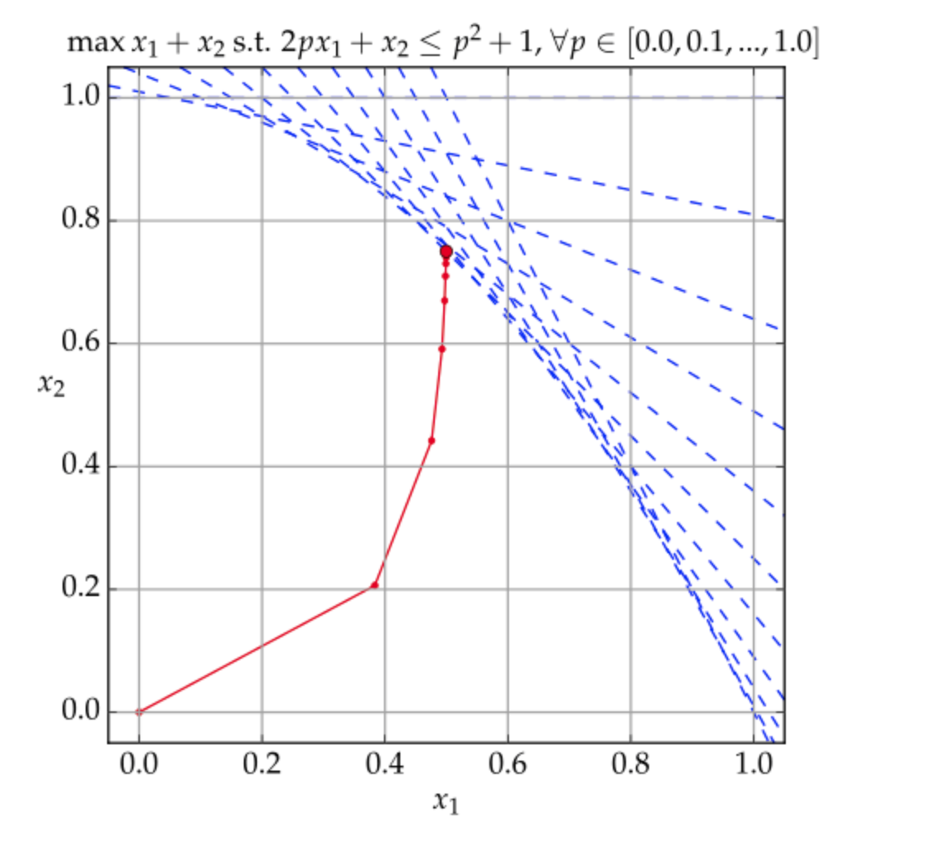
Interior–point algorithm
The solution traverses in the interior of the feasible region.

Slide 14
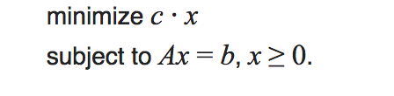
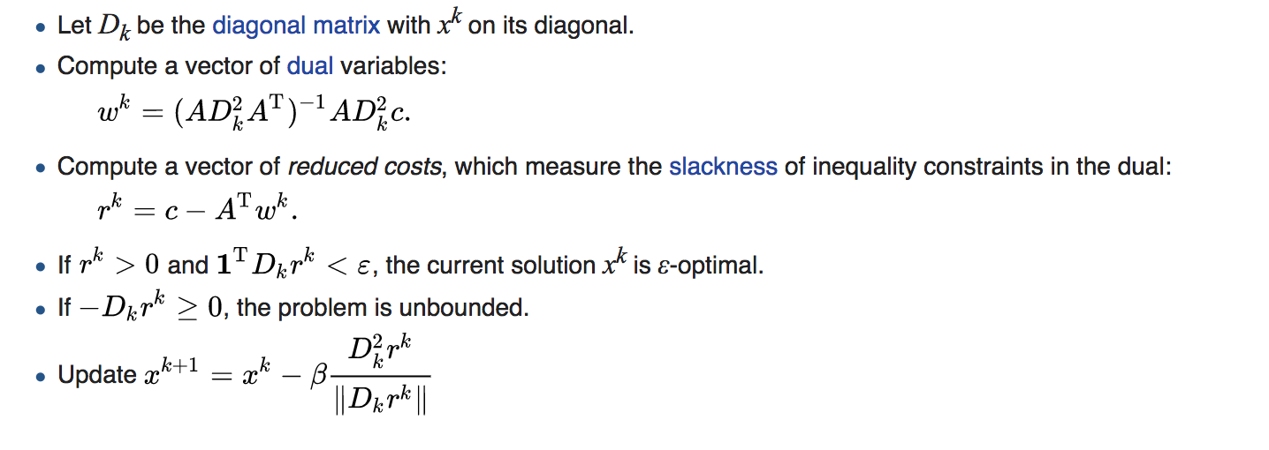
Karmarkar's method

